Slide 1
Big Mountain Resort
Data-Driven Pricing Strategy
Prepared by Justin Ali – Data Consultant

Slide 2
Business Challenge
Big Mountain Resort recently invested in a new chairlift, raising annual operating costs by $1.54 million.
While ticket prices are already higher than the market average, the resort lacked data-driven insights into how pricing and operational adjustments could offset these costs.
This analysis was conducted to determine which factors most influence ticket pricing and identify actionable strategies to maintain profitability without compromising the resort’s premium image.

Slide 3
Analytical Approach
Data from 330 ski resorts across the United States was analyzed to identify the key variables
that impact ticket pricing and operational efficiency.
The analysis included data wrangling, exploratory data analysis, and predictive modeling using regression and ensemble techniques.
By examining relationships between pricing, terrain, lifts, and snowmaking capacity, we
developed models capable of predicting optimal price ranges for Big Mountain Resort.

Slide 4
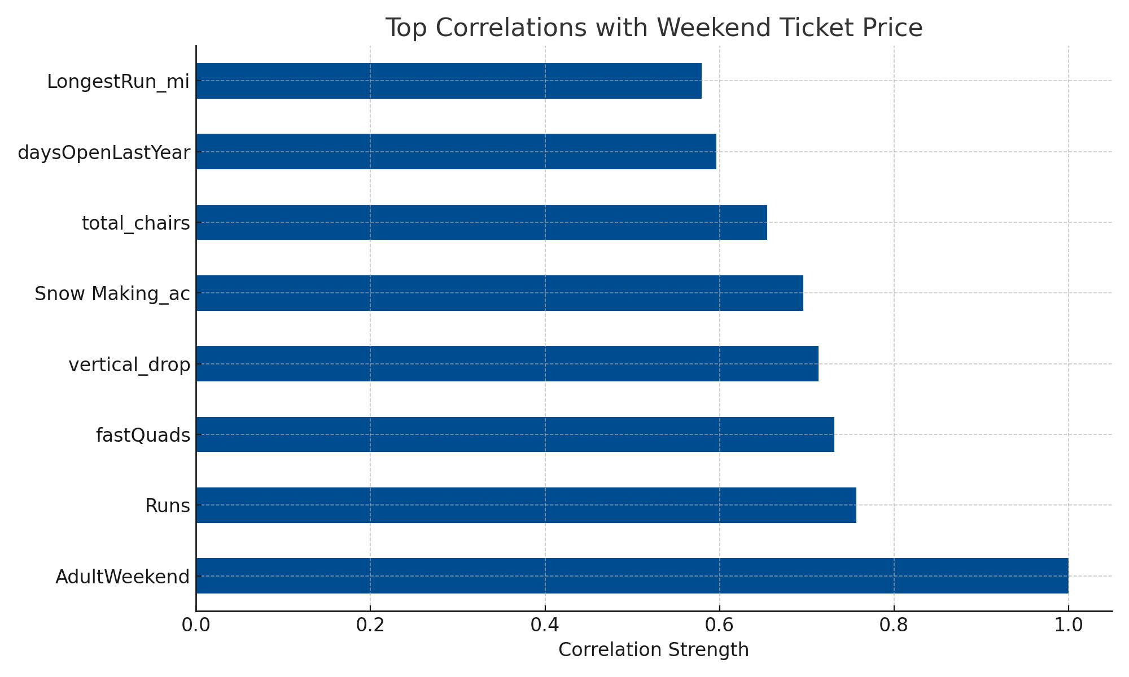
Key Pricing Drivers
The analysis revealed that vertical drop, total number of chairs, and skiable terrain are the
most influential factors affecting ticket prices.
Resorts with larger elevation changes and
more lift capacity generally command higher
prices, as these features enhance the visitor
experience and perceived value.
The bar chart highlights the strongest
correlations identified in the dataset.

Slide 5
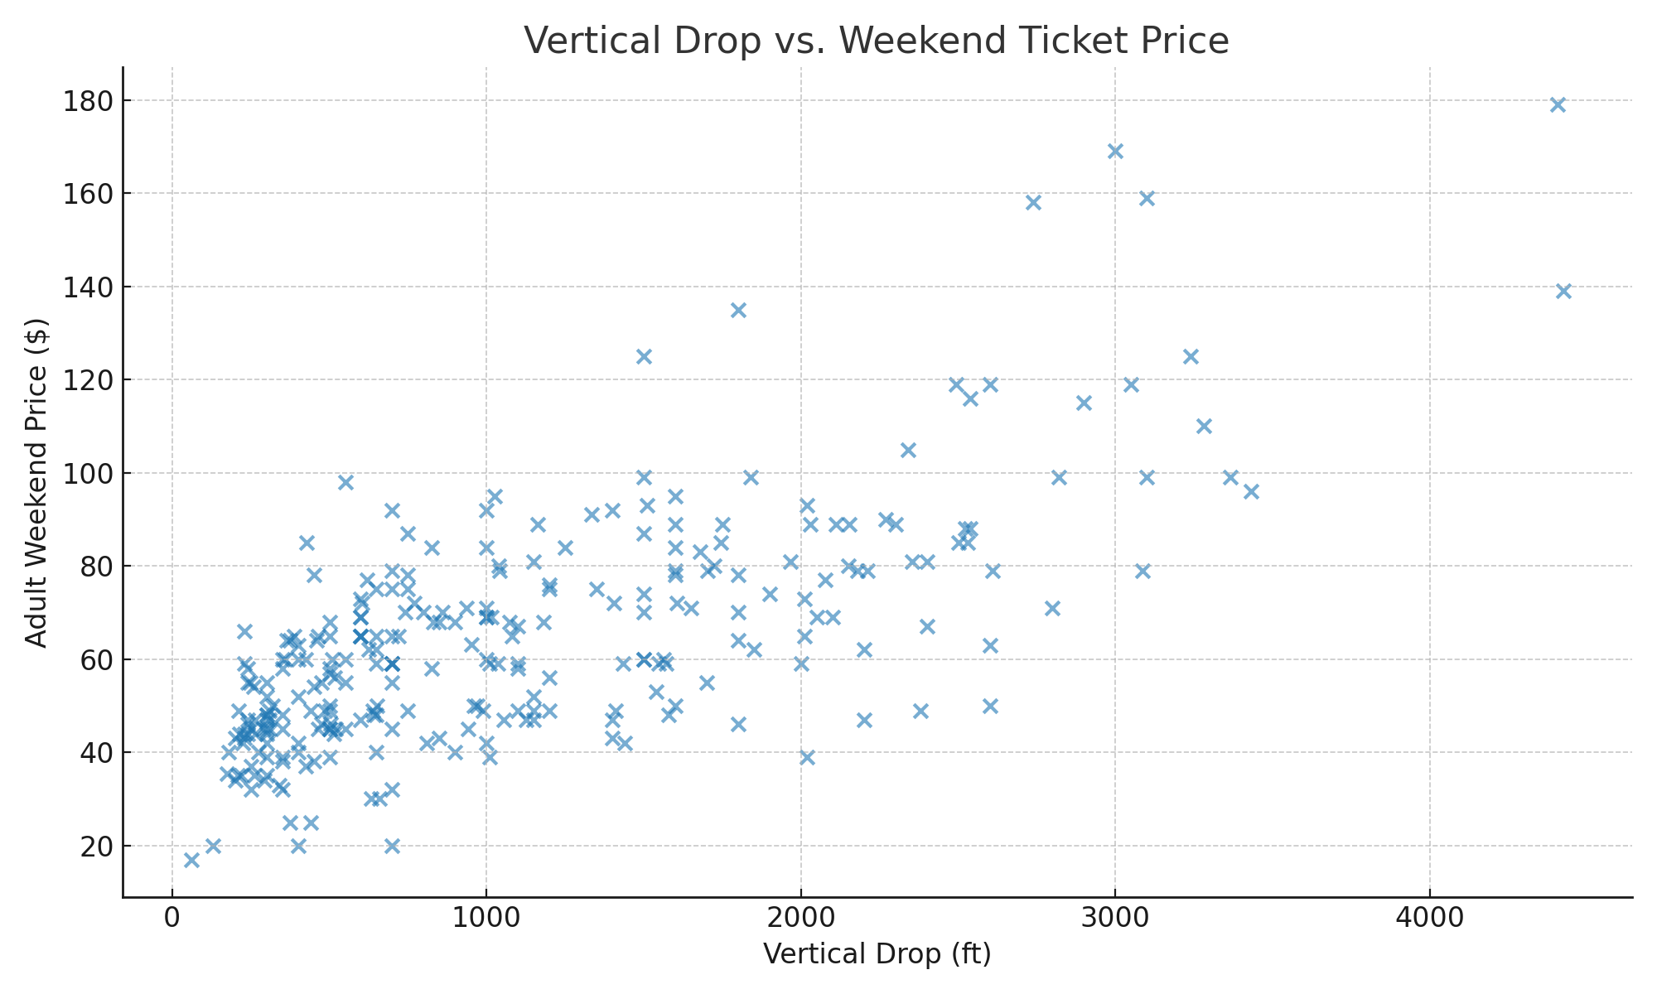
Price and Performance Insights
The scatterplot shows a clear positive relationship between a resort’s vertical drop and its
weekend ticket price. Big Mountain Resort, with a substantial vertical drop and strong facility
offerings, aligns with other high-performing resorts in terms of value delivery.
This relationship supports the conclusion
that elevation and terrain scale can
justify premium pricing when paired
with operational excellence.

Slide 6
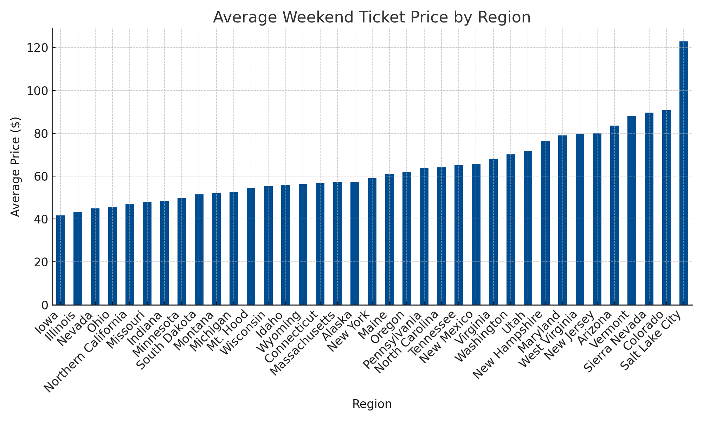
Regional Price Benchmark
Regional benchmarking shows that
Western U.S. resorts consistently
achieve the highest average ticket
prices, driven by larger mountains
and longer operating seasons.
Midwest and Southeastern resorts
fall within lower pricing tiers.
Big Mountain Resort is positioned
competitively within its region,
suggesting moderate room for
upward price adjustment to align
with comparable premium
destinations.

Slide 7
Strategic Recommendations
Based on the modeling and regional benchmarks, Big Mountain Resort should consider adjusting
its weekend ticket price to the $118–$123 range.
This adjustment balances affordability with revenue growth potential and could drive a 10–12% increase in total ticket revenue.
Operational efficiencies should focus on optimizing snowmaking and lift operations to further reduce costs without diminishing guest experience.

Slide 8
Conclusion & Next Steps
This analysis demonstrates how data-driven decision-making can help Big Mountain Resort
offset new operational expenses and enhance profitability.
By refining pricing strategies and focusing on high-impact operational areas, the resort can maintain its premium status while improving margins.
Future work should integrate real-time weather and visitor data to support
dynamic pricing models and continuous optimization.

